Slide 1


Manufacturing Processes
Chapters 5:
Bulk Deformation Processes in Metal Working
Dr. Yazan Al-Zain
Department of Industrial Engineering
University of Jordan, Amman-Jordan

Slide 2
Introduction
Bulk deformation processes in metal working include:
  Rolling.
  Other deformation processes related to rolling.
  Forging.
  Other deformation processes related to forging.
  Extrusion.
  Wire and Bar Drawing.

Slide 3
Introduction
Bulk deformation processes accomplish significant shape change in metal parts whose initial form is bulk rather than sheet.
The starting forms include (1) cylindrical bars and billets, (2) rectangular billets and slabs, and (3) similar elementary geometries.
The bulk deformation processes refine the starting shapes, sometimes improving mechanical properties, and always adding commercial value.
Deformation processes work by stressing the metal sufficiently to cause it to plastically flow into the desired shape.

Slide 4
Introduction
Bulk deformation processes are performed as (1) cold, (2) warm, and (3) hot working operations.
Cold and warm working is appropriate when the shape change is less severe, and there is a need to improve mechanical properties and achieve good finish on the part.
Hot working is generally required when massive deformation of large workparts is involved.

Slide 5
Introduction
The commercial and technological importance of bulk deformation processes derives from the following:
  When performed as hot working operations, they can achieve significant change in the shape of the workpart.
  When performed as cold working operations, they can be used not only to shape the product, but also to increase its strength through strain hardening.
  These processes produce little or no waste as a byproduct of the operation. Some bulk deformation operations are near net shape or net shape processes; they achieve final product geometry with little or no subsequent machining.

Slide 6
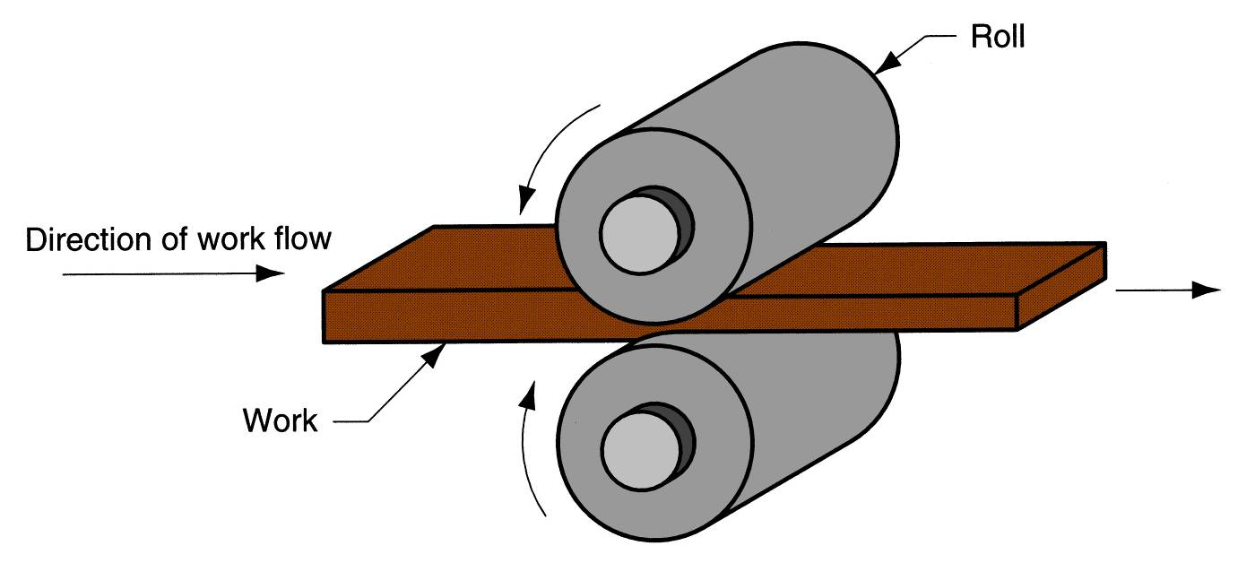
Rolling
Rolling: is a deformation process in which the thickness of the work is reduced by compressive forces exerted by two opposing rolls.
The rolls rotate to pull and simultaneously squeeze the workpart between them.
Figure 19.1 The rolling process (specifically, flat rolling).

Slide 7
Rolling
According to the part geometry, the rolling processes can be divided into:
  Flat rolling: used to reduce the thickness of a rectangular cross section.
  Shape rolling: related to flat rolling, in which a square cross section is formed into a shape such as an I-beam.

Slide 8
Rolling
Rolling can be carried out at high or low (ambient) temperatures.
  Hot rolling: most rolling is carried out by hot working, due to the large amount of deformation required.
  Hot-rolled metal is generally free of residual stresses, and its properties are isotropic (similar properties in different directions).
  Disadvantages of hot rolling are that the product cannot be held to close tolerances, and the surface has a characteristic oxide scale.

Slide 9
Rolling
Rolling can be carried out at high or low (ambient) temperatures.
  Cold rolling: less common than hot rolling.
  Cold rolling strengthens the metal and permits a tighter tolerance on thickness.
  the surface of the cold-rolled sheet is absent of scale and generally superior to the corresponding hot-rolled product.

Slide 10
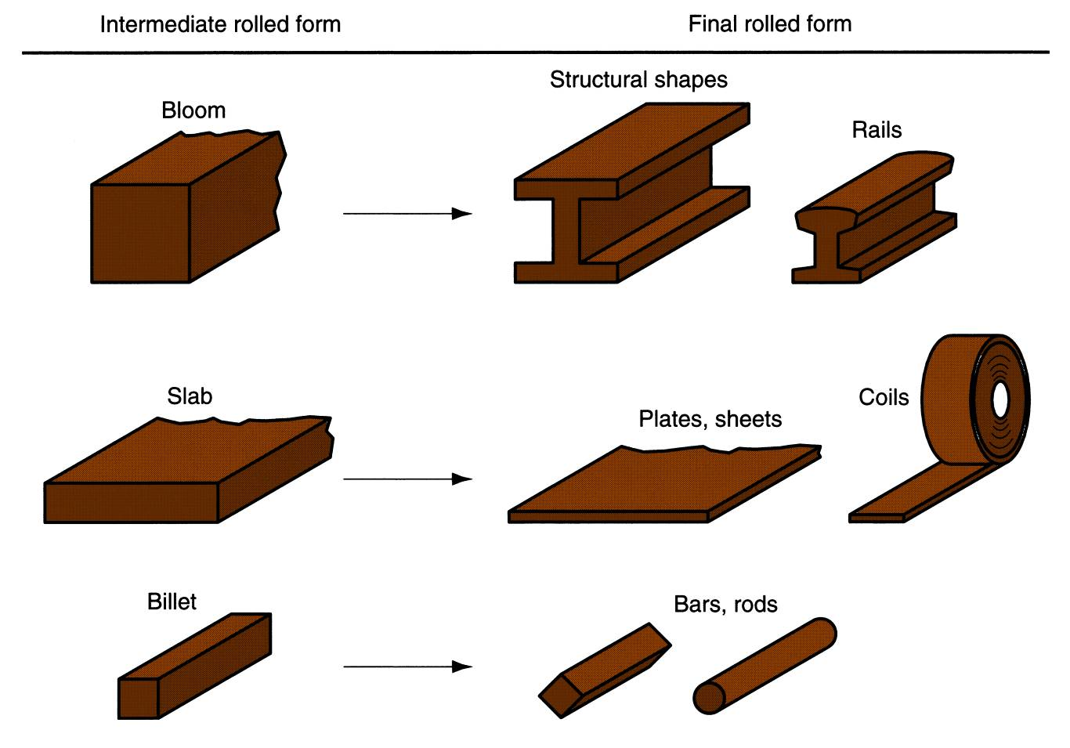
Rolling
Figure 19.2 Some of the steel products made in a rolling mill.

Slide 11
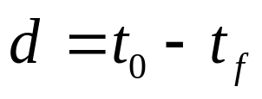
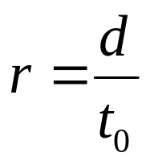
Rolling
Flat Rolling and Its Analysis
Flat rolling involves the rolling of workparts of rectangular cross section in which the width is greater than the thickness; e.g. slabs, strips, sheets and plates.
Draft is amount of thickness reduction and described as:
Draft is sometimes expressed as a fraction of the starting stock thickness, called the Reduction (r):
where d = draft, mm; t₀ = starting thickness, mm; and t_{f} = final thickness, mm.

Slide 12
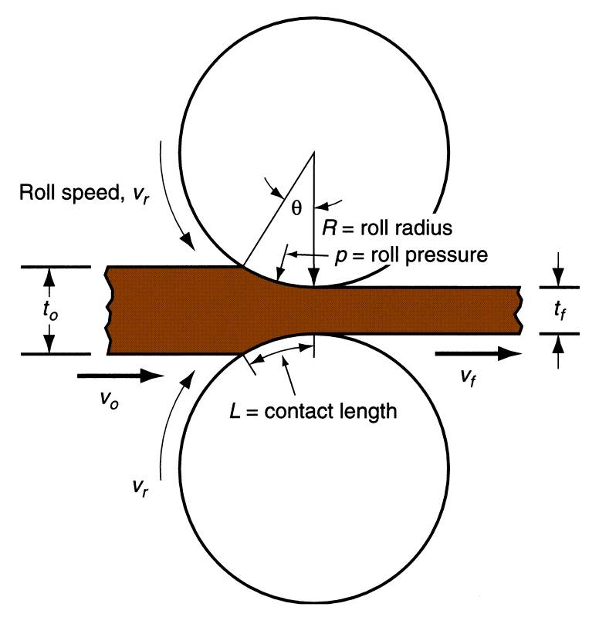
Rolling
Flat Rolling and Its Analysis
Figure 19.3 Side view of flat rolling, indicating before and after thicknesses, work velocities, angle of contact with rolls, and other features.

Slide 13
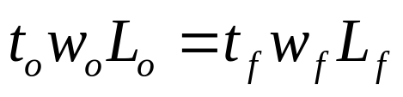
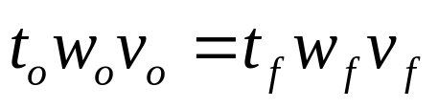
Rolling
Flat Rolling and Its Analysis
Spreading: the increase in width due to rolling, described as:
Similarly, before and after volume rates of material flow must be the same, so the before and after velocities can be related:
where w_{o} and w_{f} are the before and after work widths, mm; and L_{o} and L_{f} are the before and after work lengths, mm.
where v_{o} and v_{f} are the entering and exiting velocities of the work.

Slide 14
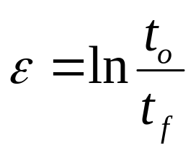
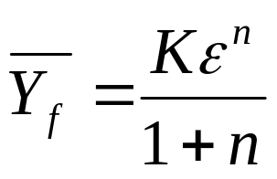
Rolling
Flat Rolling and Its Analysis
True strain is expressed by:
The true strain can be used to determine the average flow stress Y_{f} (MPa) applied to the work material in flat rolling:
The average flow stress is used to compute estimates of force and power in rolling.

Slide 15

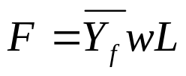
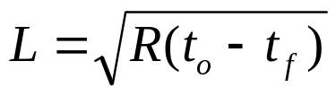


Rolling
Flat Rolling and Its Analysis
There is a limit to the maximum possible draft that can be accomplished in flat rolling with a given coefficient of friction, defined by:
Rolling force (F, N) can be expressed as:
Contact length (L, mm) is described as:
The torque (T) and the power required to drive each roll (P, J/s) are:
where d_{max} = maximum draft, mm; μ = coefficient of friction; and R = roll radius, mm.
and
where P = power, J/s or W; N = rotational speed, 1/s; F = rolling force, N; and L = contact length, m.

Slide 16
Rolling
Shape Rolling
In shape rolling, the work is deformed into a contoured cross section.
Products include construction shapes such as I-beams, L-beams, and U-channels; rails for railroad tracks; and round and square bars and rods.
The process is accomplished by passing the work through rolls that have the reverse of the desired shape.
Most of the principles that apply in flat rolling are also applicable to shape rolling.
Shaping rolls are more complicated; and the work, usually starting as a square shape, requires a gradual transformation through several rolls in order to achieve the final cross section.

Slide 17
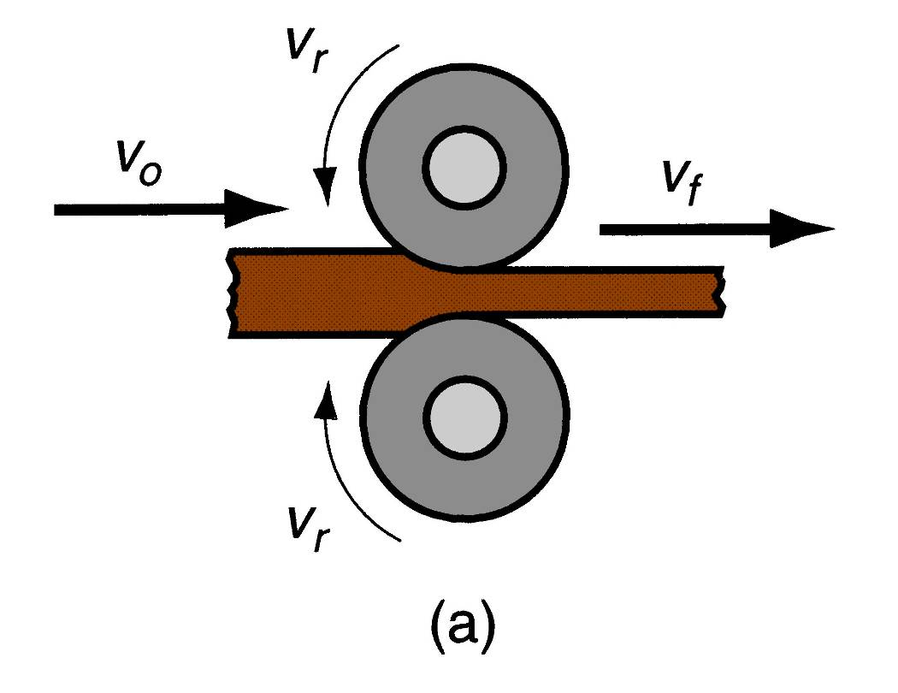
Rolling
Rolling Mills
Rolling mill configurations:
  Two-high: consists of two opposing rolls, and the configuration can be either reversing or nonreversing.
Figure 19.4 Various configurations of rolling mills: (a) two-high rolling mill.

Slide 18
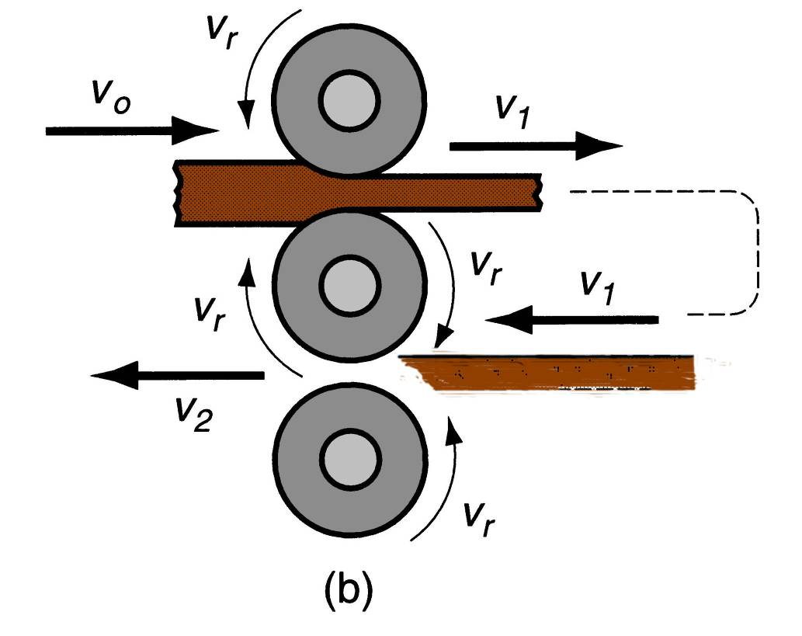
Rolling
Rolling Mills
Rolling mill configurations:
  Three-high: three rolls in a vertical column, and the direction of rotation of each roll remains unchanged.
Figure 19.4 Various configurations of rolling mills: (b) three-high rolling mill.

Slide 19
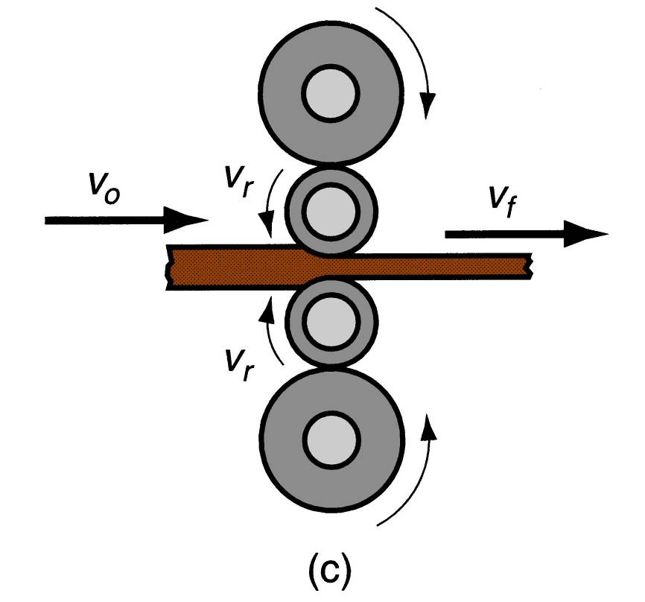
Rolling
Rolling Mills
Rolling mill configurations:
  Four-high: uses two smaller-diameter rolls to contact the work and two backing rolls behind them.
Figure 19.4 Various configurations of rolling mills: (c) four-high rolling mill.

Slide 20
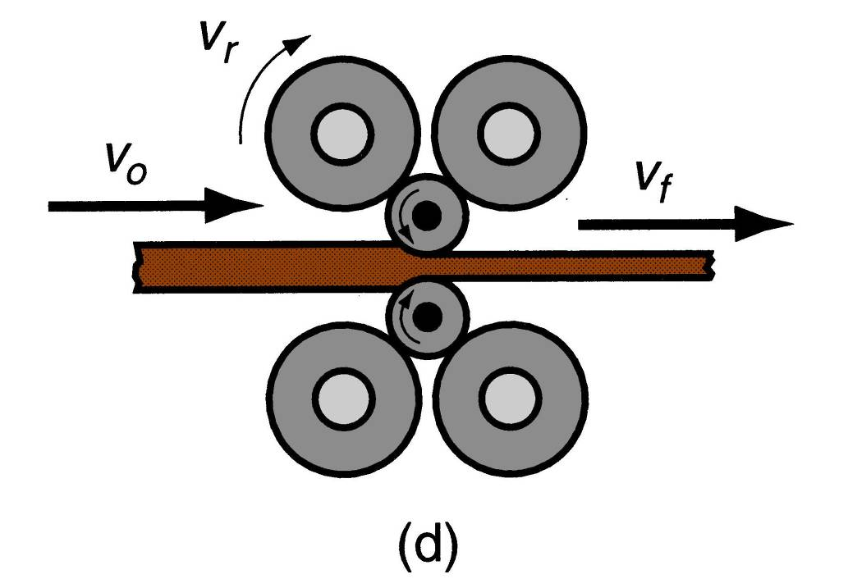
Rolling
Rolling Mills
Rolling mill configurations:
  Cluster mill: roll configuration that allows smaller working rolls against the work (smaller than in four-high mills).
Figure 19.4 Various configurations of rolling mills: (d) cluster mill.

Slide 21
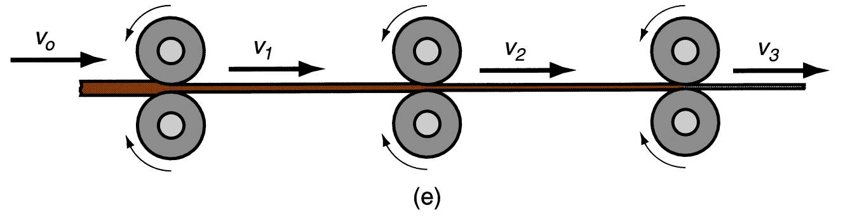
Rolling
Rolling Mills
Rolling mill configurations:
  Tandem rolling mill : consists of a series of rolling stands, aimed at higher throughput rates.
Figure 19.4 Various configurations of rolling mills: (e) tandem rolling mill.

Slide 22
Other Deformation Processes
Related to Rolling
Thread Rolling:
  Used to form threads on cylindrical parts by rolling them between two dies.
  The most important commercial process for mass producing external threaded components.
  Performed by cold working in thread rolling machines. These are equipped with special dies that determine the size and form of the thread.
  Advantages of thread rolling over thread cutting and rolling include:
    Higher production rates.
    Better material utilization.
    Smoother surface.
    Stronger threads and better fatigue resistance due to work hardening.

Slide 23
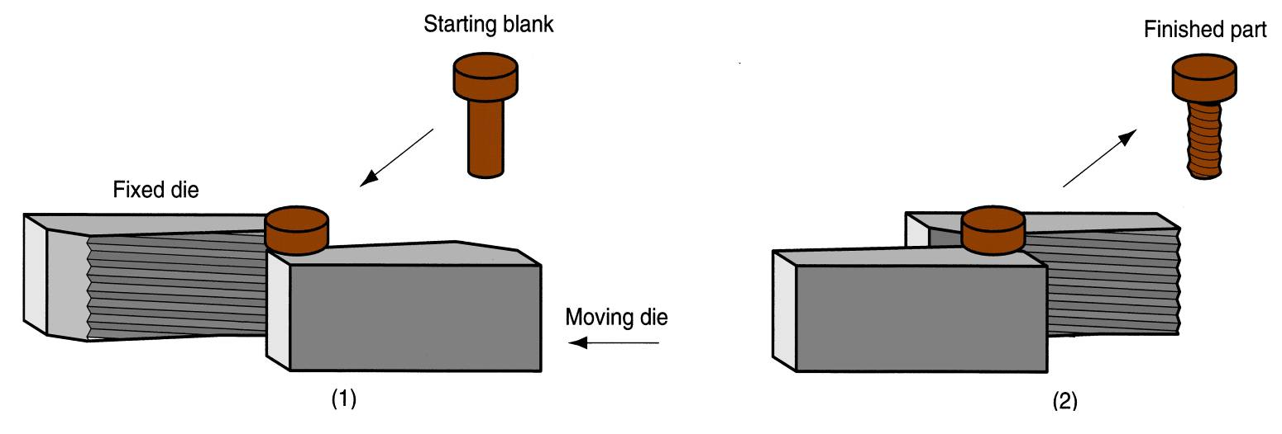
Other Deformation Processes
Related to Rolling
Thread Rolling:
Figure 19.5 Thread rolling with flat dies: (1) start, and (2) end of cycle.

Slide 24
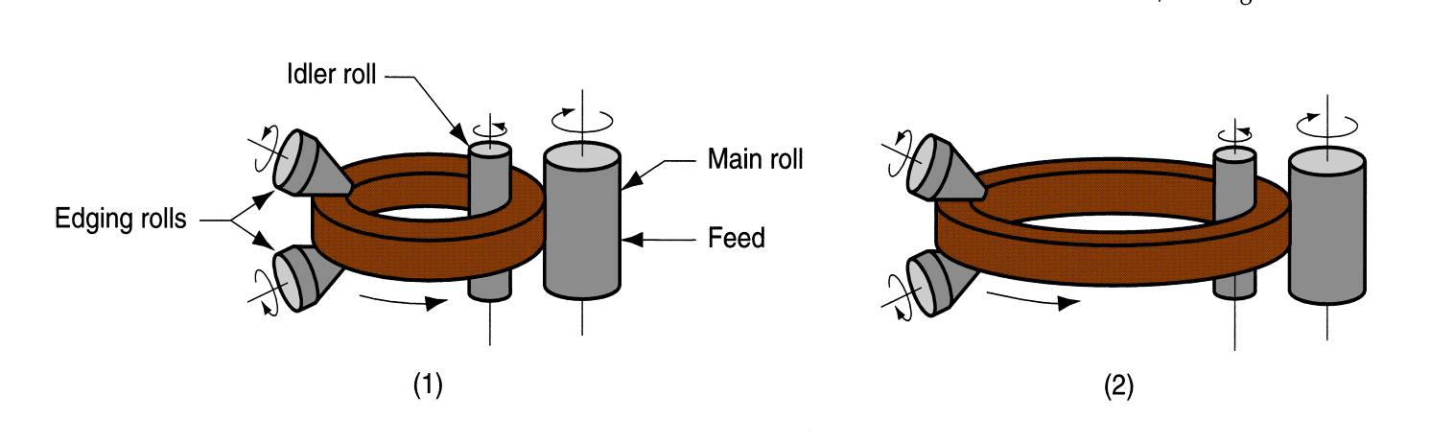
Other Deformation Processes
Related to Rolling
Ring Rolling: a deformation process in which a thick-walled ring of smaller diameter is rolled into a thin-walled ring of larger diameter.
  As the thick-walled ring is compressed, the deformed material elongates, causing the diameter of the ring to be enlarged.
Figure 19.6 Ring rolling used to reduce the wall thickness and increase the diameter of a ring: (1) start, and (2) completion of process.

Slide 25
Other Deformation Processes
Related to Rolling
Ring Rolling:
  Usually performed as a hot-working process for large rings and as a cold-working process for smaller rings.
  Applications include ball and roller bearing races, steel tires for railroad wheels, and rings for pipes, pressure vessels, and rotating machinery.
  Advantages over processes producing similar products include: (1) raw material savings, (2) ideal grain orientation for the application, and (3) strengthening through cold working.

Slide 26
Other Deformation Processes
Related to Rolling
Roll Piercing: a specialized hot working process for making seamless thick-walled tubes.
  Based on the principle that when a solid cylindrical part is compressed on its circumference, high tensile stresses are developed at its center. If compression is high enough, an internal crack is formed.
  Compressive stresses on a solid cylindrical billet are applied by two rolls, whose axes are oriented at slight angles (6º) from the axis of the billet, so that their rotation tends to pull the billet through the rolls. A mandrel is used to control the size and finish of the hole created by the action.

Slide 27
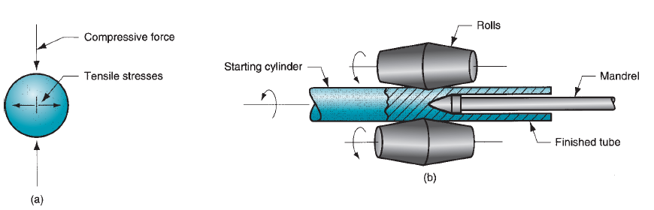
Other Deformation Processes
Related to Rolling
Roll Piercing:
Figure 19.7 Roll piercing: (a) formation of internal stresses and cavity by compression of cylindrical part; and (b) setup of Mannesmann roll mill for producing seamless tubing.

Slide 28
Forging
Forging: a deformation process in which the work is compressed between two dies, using either impact or gradual pressure to form the part.
  Dates back to perhaps 5000 BCE.
  Today, forging is an important industrial process used to make a variety of high-strength components for automotive, aerospace, and other applications.
  These components include engine crankshafts and connecting rods, gears, aircraft structural components, and jet engine turbine parts.
  In addition, steel and other basic metals industries use forging to establish the basic form of large components that are subsequently machined to final shape and dimensions.

Slide 29
Forging
Forging can be classified in many ways, one is working temperature.
  Hot or warm forging: done when significant deformation is demanded by the process and when strength reduction and increase of ductility is required.
  Cold forging: its advantage is the increased strength that results from strain hardening of the component.
The other way is by the way the forging is carried out:
  Forging hammer: a forging machine that applies an impact load.
  Forging press: a forging machine that applies gradual load.

Slide 30
Forging
Forging can be also classified according to the degree to which the flow of the work metal is constrained by the dies.
  Open-die forging: the work is compressed between two flat dies, thus allowing the metal to flow without constraint in a lateral direction relative to the die surfaces.
  Impression-die forging: the die surfaces contain a shape or impression that is imparted to the work during compression, thus constraining metal flow to a significant degree. Here, flash will form.
  Flashless forging: the work is completely constrained within the die and no excess flash is produced.

Slide 31
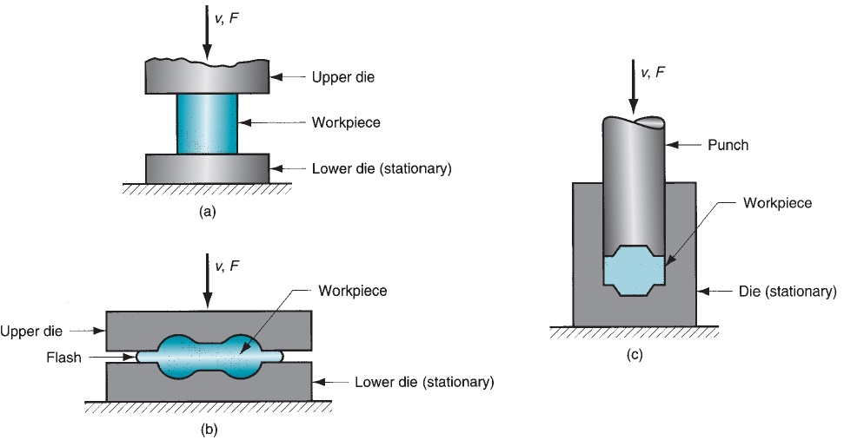
Forging
Figure 19.8 Three types of forging operation: (a) open-die forging, (b) impression-die forging, and (c) flashless forging.

Slide 32
Forging
Open-Die Forging
Known as upsetting or upset forging.
Involves compression of a workpart of cylindrical cross section between two flat dies, much in the manner of a compression test.
It reduces the height of the work and increases the diameter.

Slide 33
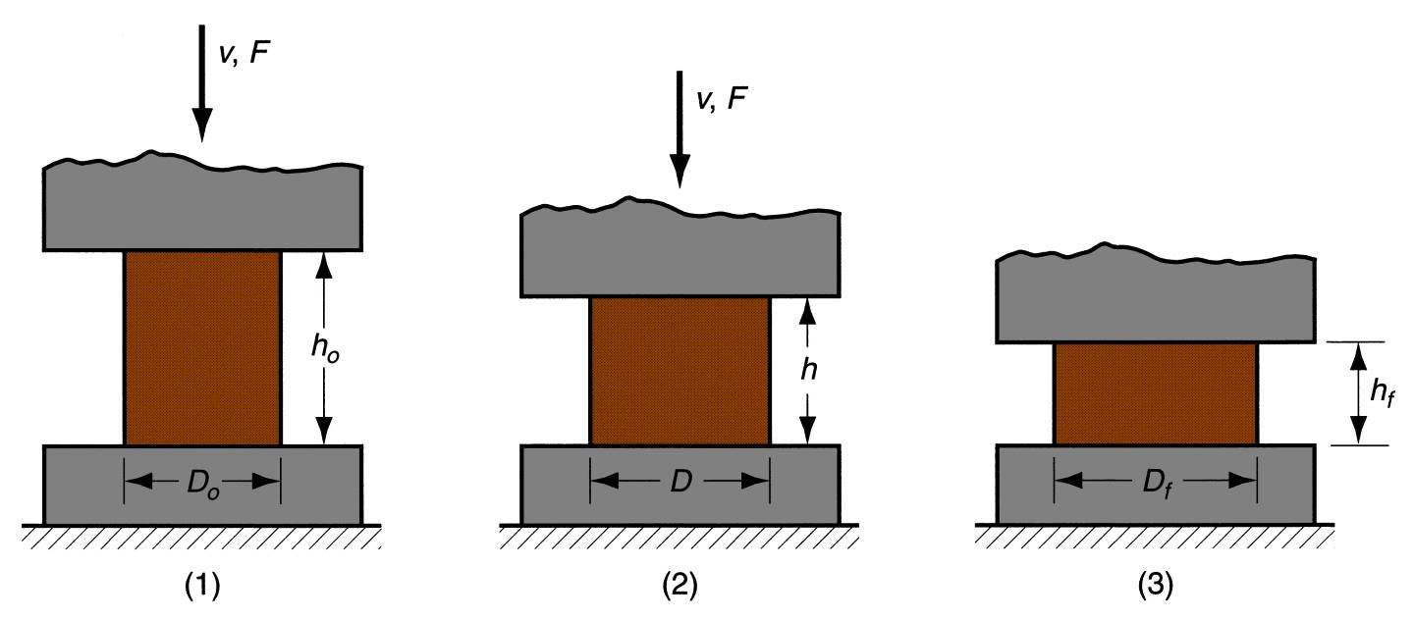
Forging
Open-Die Forging
Analysis of Open-Die Forging:
  If carried out under ideal conditions of no friction between work and die surfaces, then homogeneous deformation occurs, and the flow of the material is uniform throughout its height.
Figure 19.9 Homogeneous deformation of a cylindrical workpart under ideal conditions in an open‑die forging operation: (1) start of process with workpiece at its original length and diameter, (2) partial compression, and (3) final size.

Slide 34
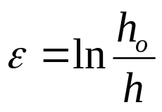

Forging
Open-Die Forging
Analysis of Open-Die Forging:
  Under these ideal conditions, the true strain experienced by the work during the process can be determined by:
  The force to perform upsetting at any height is given by:
where F = force, N; A = cross-sectional area, mm²; and Y_{f} = flow stress, MPa.

Slide 35
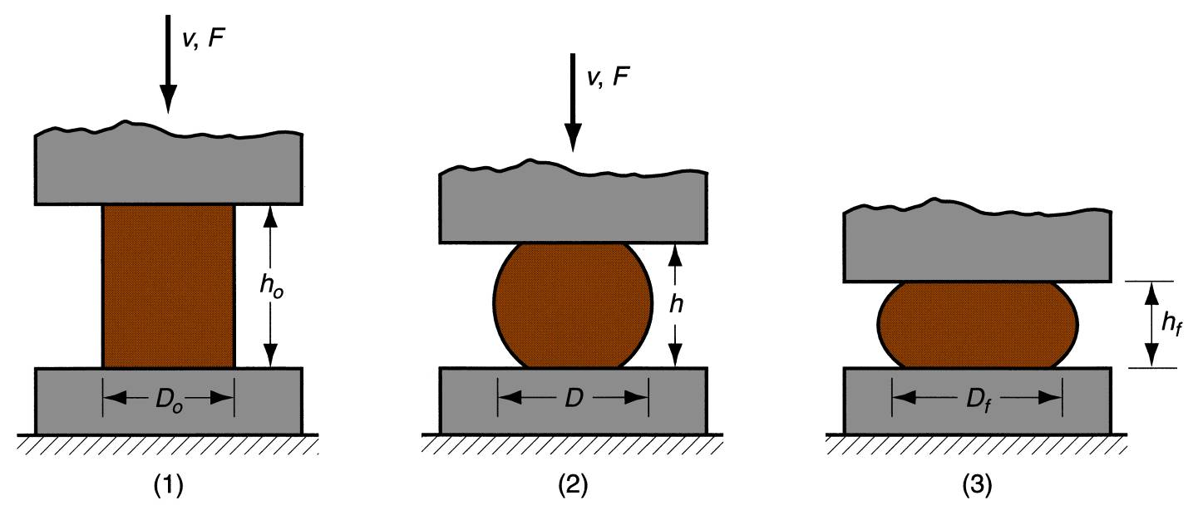
Forging
Open-Die Forging
Analysis of Open-Die Forging:
  If carried out under conditions where friction between work and die surfaces is accounted for, a barreling effect is created.
Figure 19.10 Actual deformation of a cylindrical workpart in open-die forging, showing pronounced barreling: (1) start of process, (2) partial deformation, and (3) final shape.

Slide 36

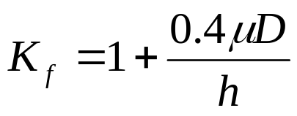
Forging
Open-Die Forging
Analysis of Open-Die Forging:
  Friction causes the actual upsetting force to be greater than what is predicted the previous equation:
where K_{f} is the forging shape factor, defined as:
where μ = coefficient of friction; D = workpart diameter or other dimension representing contact length with die surface, mm; and h = workpart height, mm.

Slide 37
Forging
Open-Die Forging
In practice, open-die forging can be classified into:
  Fullering: a forging operation performed to reduce the cross section and redistribute the metal in a workpart in preparation for subsequent shape forging (dies have convex surfaces).
  Edging: similar to fullering, except that the dies have concave surfaces.
  Cogging: consists of a sequence of forging compressions along the length of a workpiece to reduce cross section and increase length.

Slide 38
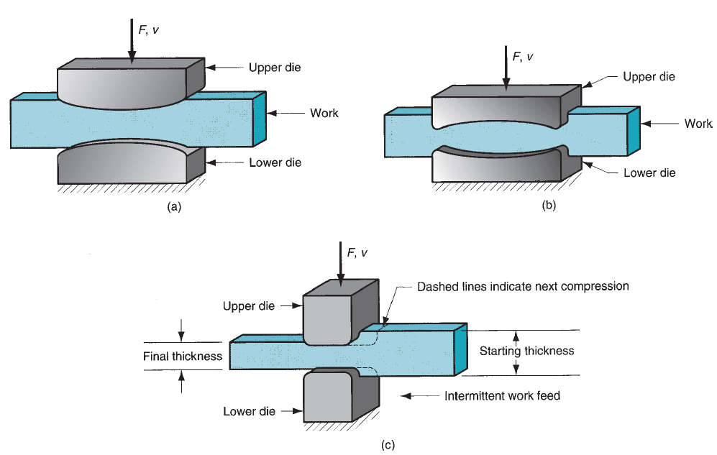
Forging
Open-Die Forging
Figure 19.11 Several open-die forging operations: (a) fullering, (b) edging, and (c) cogging.

Slide 39
Forging
Impression-Die Forging
Impression-die forging (sometimes called closed-die forging): performed with dies that contain the inverse of the desired shape of the part.
  As the die closes to its final position, flash is formed by metal that flows beyond the die cavity and into the small gap between the die plates.
  Although this flash must be finally cut away, it serves an important function during impression-die forging.
    As the flash begins to form, friction resists continued flow of metal into the gap, thus constraining the bulk of the work material to remain in the die cavity.
    In hot forging, metal flow is further restricted because the thin flash cools quickly against the die plates, thereby increasing its resistance to deformation.
    Accordingly, compression pressure is increased, thus forcing the material to fill the whole cavity.

Slide 40
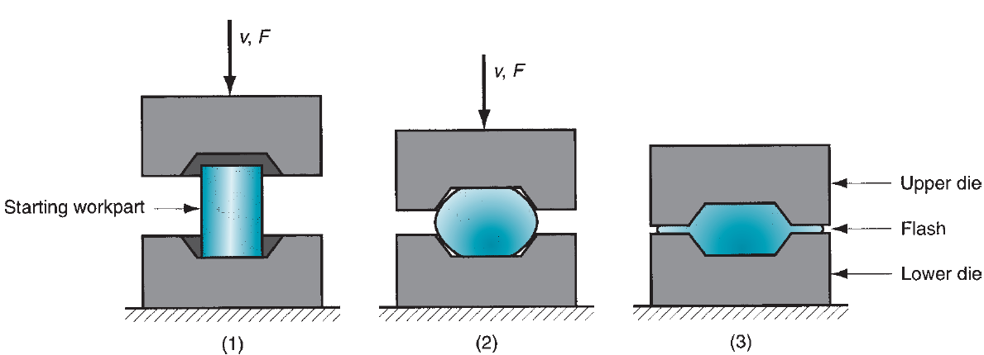
Forging
Impression-Die Forging
Sequence in impression-die forging:
Figure 19.12 Sequence in impression-die forging: (1) just prior to initial contact with raw workpiece, (2) partial compression, and (3) final die closure, causing flash to form in gap between die plates.

Slide 41
Forging
Impression-Die Forging
Advantages of impression-die forging compared to machining from solid stock include: higher production rates, less waste of metal, greater strength and favorable grain orientation in the metal.
Limitations include: the incapability of close tolerances and machining is often required to achieve accuracies and features needed.

Slide 42
Forging
Flashless Forging
Flashless Forging: the raw workpiece is completely contained within the die cavity during compression, and no flash is formed.
Several requirements:
  The work volume must equal the space in the die cavity within a very close tolerance.
  If the starting blank is too large, excessive pressures may cause damage to the die or press. If the blank is too small, the cavity will not be filled.
  Simple geometries required.
  Best for soft metals, such as aluminum and cupper and their alloys.
  Sometimes classified as Precision Forging.

Slide 43
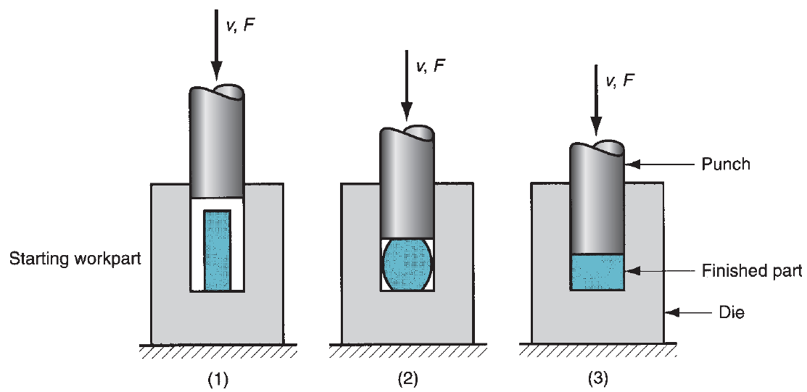
Forging
Flashless Forging
Figure 19.13 Flashless forging: (1) just before initial contact with workpiece, (2) partial compression, and (3) final punch and die closure.

Slide 44
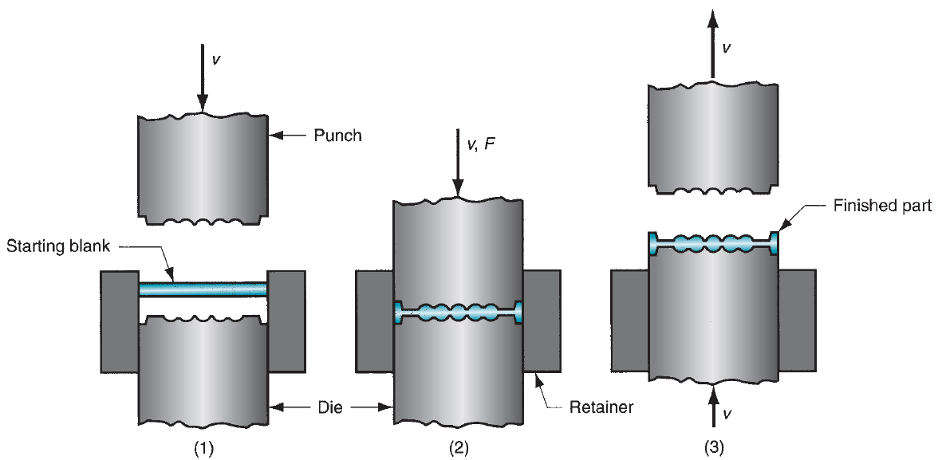
Forging
Flashless Forging
Coining: is a type of flashless forging, in which fine details in the die are impressed into the top and bottom surfaces of the workpart. There is little flow of metal in coining.
Figure 19.14 Coining operation: (1) start of cycle, (2) compression stroke, and (3) ejection of finished part.

Slide 45
Forging
Forging Hammers and Presses
Equipment used in forging consists of forging machines, classified as hammers or presses, and forging dies.
In addition, auxiliary equipment is needed, such as furnaces to heat the work, mechanical devices to load and unload the work, and trimming stations to cut away the flash in impression-die forging.

Slide 46
Forging
Forging Hammers and Presses
(1) Forging Hammers: operate by applying an impact loading against the work. They deliver impact energy to the workpiece.
  Used for impression-die forging.
  The upper portion of the forging die is attached to the ram, and the lower portion is attached to the anvil.
  The work is placed on the lower die, and the ram is lifted and then dropped.
  When the upper die strikes the work, the impact energy causes the part to assume the form of the die cavity.
  Several blows of the hammer are often required to achieve the desired change in shape.

Slide 47
Forging
Forging Hammers and Presses
Forging hammers are classified into:
Gravity drop hammers: achieve their energy by the falling weight of a heavy ram, and the force of the blow is determined by the height of the drop and the weight of the ram.
Power drop hammers: accelerate the ram by pressurized air or steam.
Disadvantage: a large amount of the impact energy is transmitted through the anvil and into the floor of the building.

Slide 48
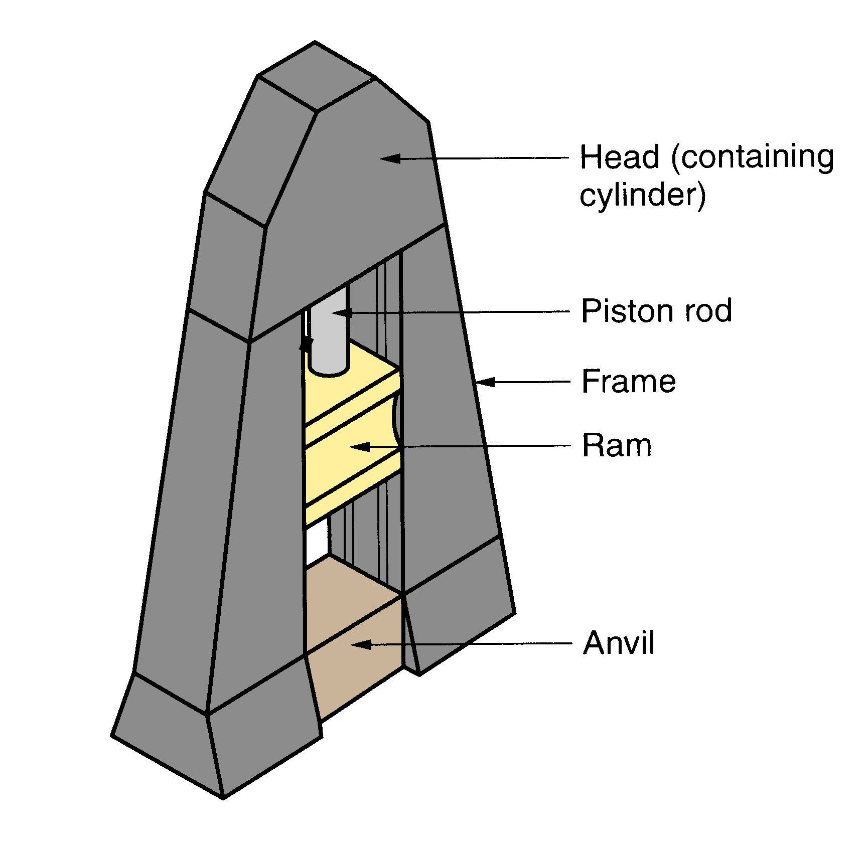
Forging
Forging Hammers and Presses
Figure 19.15 Diagram showing details of a drop hammer for impression‑die forging.

Slide 49
Forging
Forging Hammers and Presses
(2) Forging Presses: apply gradual pressure, rather than sudden impact, to accomplish the forging operation.
  Include mechanical presses, hydraulic presses, and screw presses.
  Mechanical presses convert the rotating motion of a drive motor into the translation motion of the ram.
  Hydraulic presses use a hydraulically driven piston to drive the ram.
  Screw presses apply force by a screw mechanism that drives the vertical ram.

Slide 50
Other Deformation Processes
Related to Forging
Upsetting and Heading: a deformation operation in which a cylindrical workpart is increased in diameter and reduced in length.
Used in the fastener industry to form heads on nails, bolts, etc (in these applications, it is referred to as heading).
More parts produced by upsetting than any other forging operation.
Performed cold, hot or warm on special upset forging machines, called headers or formers.
Long wire is fed into the machines, the end of the stock is upset forged, and then the piece is cut to length to make the desired hardware item.

Slide 51
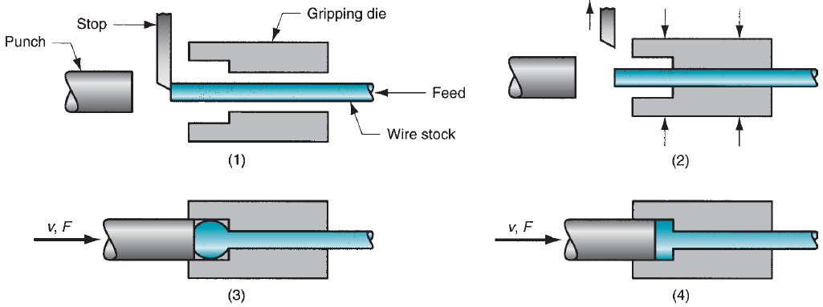
Other Deformation Processes
Related to Forging
Upsetting and Heading: a deformation operation in which a cylindrical workpart is increased in diameter and reduced in length.
Figure 19.16 An upset forging operation to form a head on a bolt. (1) wire stock is fed to the stop; (2) gripping dies close on the stock and the stop is retracted; (3) punch moves forward; and (4) bottoms to form the head.

Slide 52
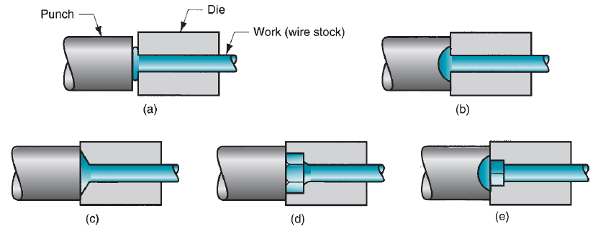
Other Deformation Processes
Related to Forging
Upsetting and Heading: a deformation operation in which a cylindrical workpart is increased in diameter and reduced in length.
Figure 19.17 Examples of heading (upset forging) operations: (a) heading a nail using open dies, (b) round head formed by punch, (c) and (d) heads formed by die, and (e) carriage bolt head formed by punch and die.

Slide 53
Other Deformation Processes
Related to Forging
Swaging and Radial Forging: forging processes used to reduce the diameter of a tube or solid rod.
The swaging process is accomplished by means of rotating dies that hammer a workpiece radially inward to taper it as the piece is fed into the dies.
Radial forging is similar to swaging in its action against the work and is used to create similar part shapes. The difference is that in radial forging the dies do not rotate around the workpiece; instead, the work is rotated as it feeds into the hammering dies.

Slide 54
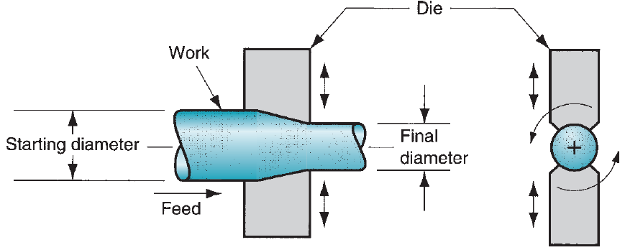
Other Deformation Processes
Related to Forging
Figure 19.18 Swaging process to reduce solid rod stock; the dies rotate as they hammer the work. In radial forging, the workpiece rotates while the dies remain in a fixed orientation as they hammer the work.

Slide 55
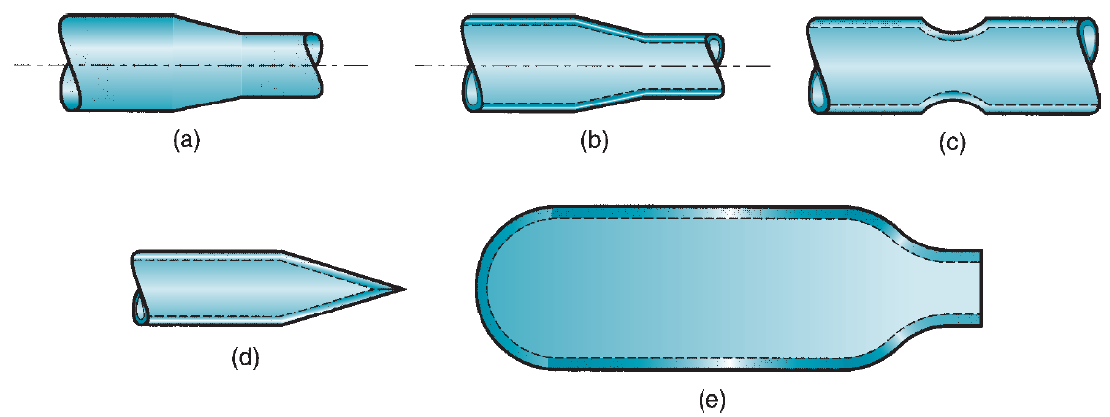
Other Deformation Processes
Related to Forging
Figure 19.19 Examples of parts made by swaging: (a) reduction of solid stock, (b) tapering a tube, (c) swaging to form a groove on a tube, (d) pointing of a tube, and (e) swaging of neck on a gas cylinder.

Slide 56
Other Deformation Processes
Related to Forging
Trimming: an operation used to remove flash on the workpart in impression-die forging.
In most cases, trimming is accomplished by shearing.
Trimming is usually done while the work is still hot.
In cases where the work might be damaged by the cutting process, trimming may be done by alternative methods, such as grinding or sawing.

Slide 57
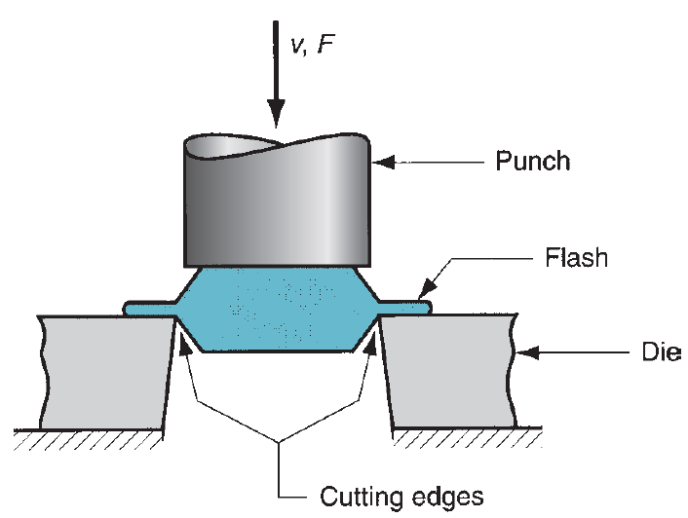
Other Deformation Processes
Related to Forging
Figure 19.20 Trimming operation (shearing process) to remove the flash after impression-die forging.

Slide 58
Extrusion
Extrusion: a compression process in which the work metal is forced to flow through a die opening to produce a desired cross-sectional shape.
Imagine squeezing toothpaste out of toothpaste tube.
Advantages include:
  A variety of shapes are possible (especially in hot extrusion).
  Microstructure and strength are enhanced in cold and warm extrusion.
  Close tolerances are possible, especially in cold extrusion.
  in some extrusion operations, little or no wasted material is created.

Slide 59
Extrusion
Types of Extrusion
Extrusion can be classified in various ways:
  By physical configuration: Direct Extrusion and Indirect Extrusion.
  By working temperature: Cold, Warm, or Hot Extrusion.
  Finally, it is performed as either a Continuous or Discrete process.

Slide 60
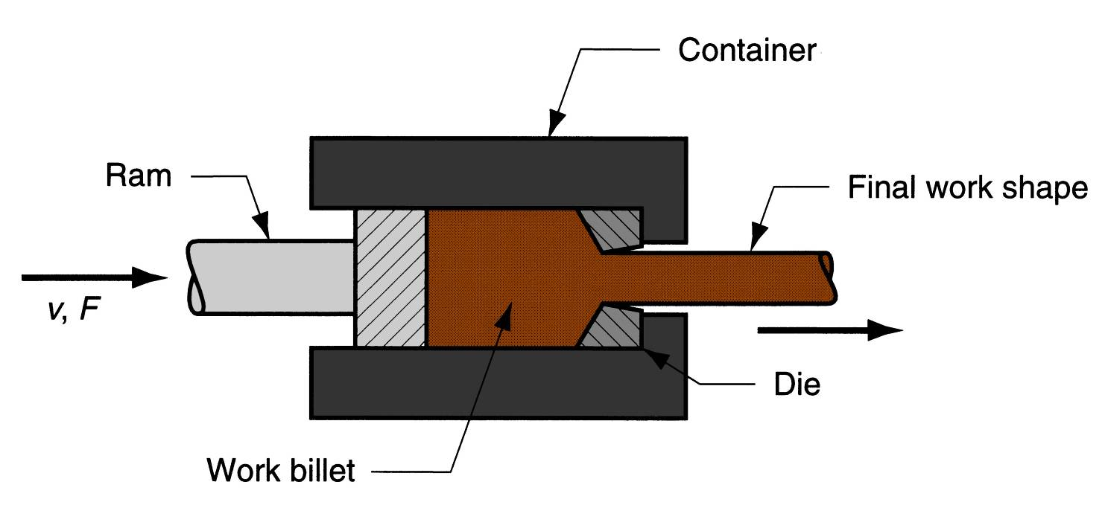
Extrusion
Types of Extrusion
Direct versus Indirect Extrusion: (1) Direct extrusion (also called forward extrusion) is illustrated in the Figure below.
Figure 19.21 Direct extrusion.

Slide 61
Extrusion
Direct Extrusion
A metal billet is loaded into a container, and a ram compresses the material, forcing it to flow through one or more openings in a die at the opposite end of the container.
As the ram approaches the die, a small portion of the billet remains that cannot be forced through the die opening.
This extra portion, called the butt, is separated from the product by cutting it just beyond the exit of the die.
Friction between container’s walls and workpiece is one big problem in extrusion (so higher forces are needed to accomplish the process).
The problem is aggravated in hot extrusion due to formation of oxide layer.

Slide 62
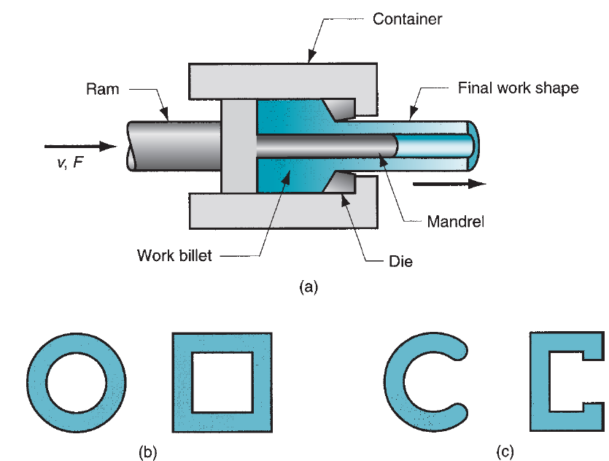
Extrusion
Direct Extrusion
Figure 19.22 (a) Direct extrusion to produce a hollow or semi-hollow cross section; (b) hollow and (c) semi-hollow cross sections.

Slide 63
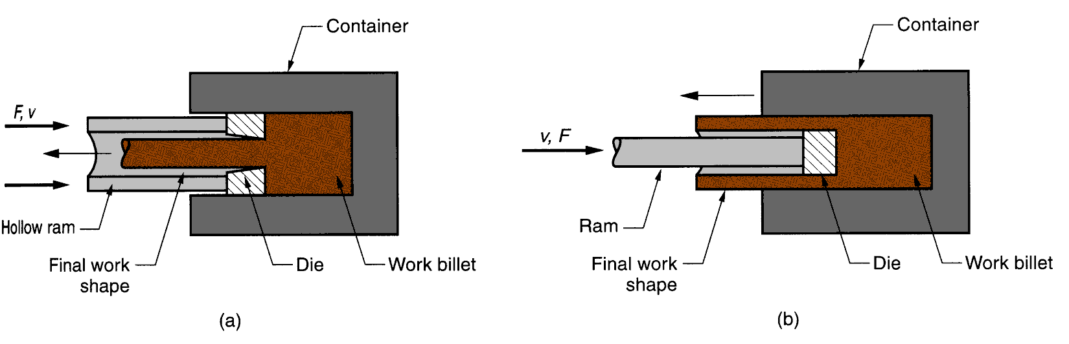
Extrusion
Types of Extrusion
Direct versus Indirect Extrusion: (2) Indirect extrusion (also called backward extrusion) is illustrated in the Figure below.
Figure 19.23 Indirect extrusion to produce (a) a solid cross section and (b) a hollow cross section.

Slide 64
Extrusion
Indirect Extrusion
The die is mounted to the ram rather than at the opposite end of the container.
As the ram penetrates into the work, the metal is forced to flow through the clearance in a direction opposite to the motion of the ram.
Since the billet is not forced to move relative to the container, there is no friction at the container walls, and the ram force is therefore lower than in direct extrusion.
Limitations of indirect extrusion are imposed by the lower rigidity of the hollow ram and the difficulty in supporting the extruded product as it exits the die.

Slide 65
Extrusion
Types of Extrusion
Hot versus Cold Extrusion:
  Extrusion can be performed either hot or cold, depending on work metal and amount of strain to which it is subjected during deformation.
  Hot extruded metals include: Al, Cu, Mg, Zn, Sn, and their alloys (sometimes extruded cold as well).
  Steel alloys are usually extruded hot, although the softer, more ductile grades are sometimes cold extruded (e.g. low C-steels).
  Al is probably the most ideal metal for extrusion (hot and cold).
  Products include: doors and window frames.

Slide 66
Extrusion
Types of Extrusion
Hot Extrusion:
  Involves prior heating of the billet to a temperature above its recrystallization temperature.
  This reduces strength and increases ductility.
  Additional advantages include reduction of ram force, and increased ram speed.

Slide 67
Extrusion
Types of Extrusion
Cold Extrusion:
  Used to produce discrete parts, in finished (or near finished) form.
  Impact Extrusion: indicates high-speed cold extrusion.
  Advantages: increased strength due to strain hardening, close tolerances, improved surface finish, absence of oxide layers, and high production rates.

Slide 68
Extrusion
Types of Extrusion
Continuous versus Discrete Extrusion:
  Continuous Extrusion: producing very long sections in one cycle, but these operations are limited by the size of the starting billet that can be loaded into the extrusion container. In nearly all cases, the long section is cut into smaller lengths in a subsequent sawing or shearing operation.
  Discrete Extrusion: a single part is produced in each extrusion cycle. Impact extrusion is an example of the discrete processing case.

Slide 69
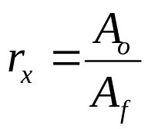
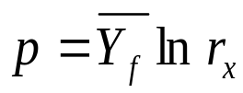
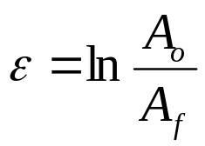
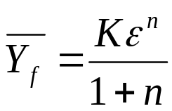
Extrusion
Analysis of Extrusion
Consider the figure below:
Extrusion ratio:
Idea (no friction) case, pressure p:
True strain:
Average flow stress (MPa):
NOTE: This is ideal case (no friction considered).
The workpiece has round cross section

Slide 70

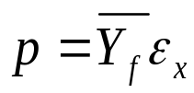
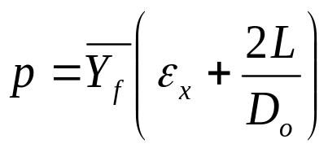


Extrusion
Analysis of Extrusion
If friction is considered:
Extrusion strain:
where a & b are constants for a given die angle: a = 0.8 & b = 1.2 to 1.5.
For indirect extrusion:
For direct extrusion, friction is higher, so:
Ram forces in indirect or direct extrusion, F (N):
Power required P (J/s):
v is velocity in m/s
NOTE: friction considered and cross section is round.

Slide 71
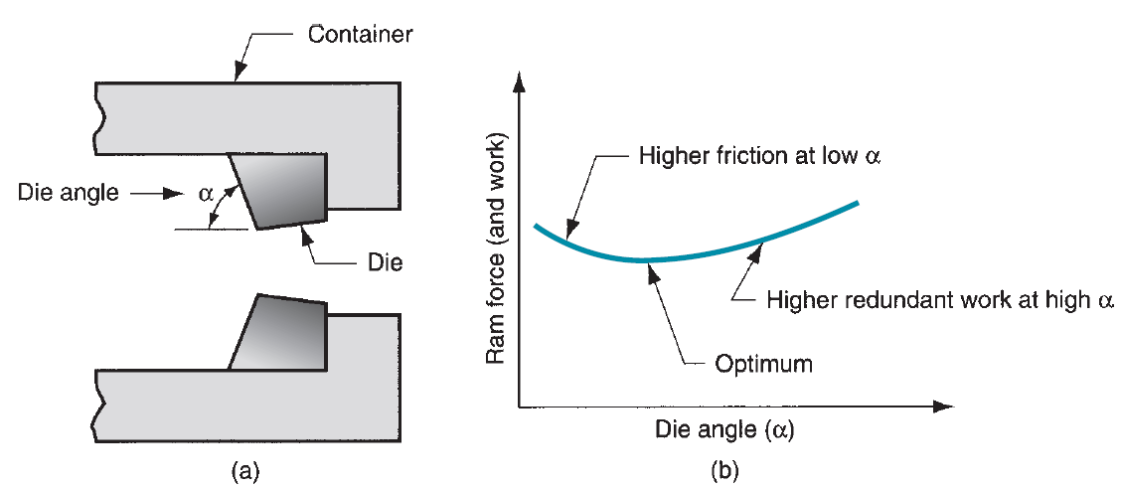
Extrusion
Extrusion Dies and Presses
Figure 19.24 (a) Definition of die angle in direct extrusion; (b) effect of die angle on ram force.
Low die angles (α): high friction so high ram force.
High die angles (α): more turbulence, so increased ram force.
An optimum die angle exists.

Slide 72
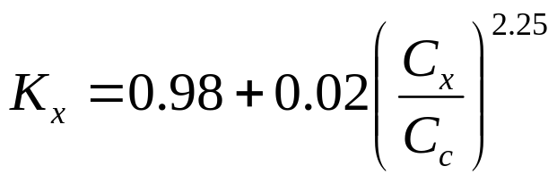
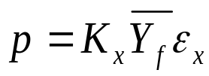
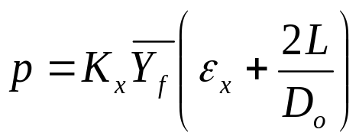
Extrusion
Extrusion Dies and Presses
The effect of the die orifice shape can be assessed by the die shape factor, can be expressed as follows:
where K_{x} = die shape factor in extrusion; C_{x} = perimeter of the extruded cross section, mm; and C_{c} = perimeter of a circle of the same area as the extruded shape, mm.
K_{x} for circular shape = 1
K_{x} for hollow, thin-walled sections is higher.
For indirect extrusion:
For shapes other than round.
For direct extrusion:

Slide 73
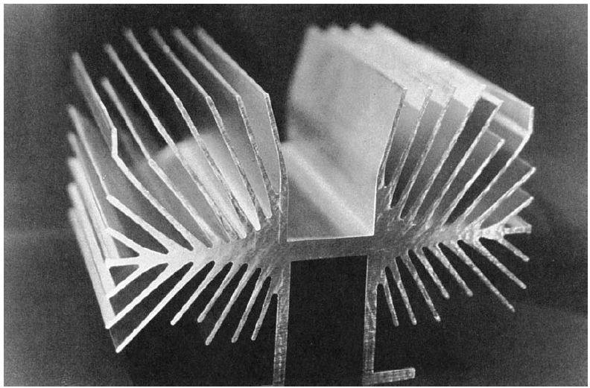
Extrusion
Extrusion Dies and Presses
Figure 19.25 A complex extruded cross section for a heat sink. (Photo courtesy of Aluminum Company of America, Pittsburg, Pennsylvania).

Slide 74
Extrusion
Extrusion Dies and Presses
Extrusion presses: either horizontal or vertical, depending on orientation of the work axis.
Usually hydraulically driven.
This drive is especially suited to semi-continuous production of long sections, as in direct extrusion.
Mechanical drives are often used for cold extrusion of individual parts, such as in impact extrusion.

Slide 75
Extrusion
Defects in Extrusion
Centerburst: an internal crack that develops as a result of tensile stresses along the centerline of the workpart during extrusion. Conditions that promote centerburst are high die angles, low extrusion ratios, and impurities.
Piping: a defect associated with direct extrusion. It is the formation of a sink hole in the end of the billet. The use of a dummy block whose diameter is slightly less than that of the billet helps to avoid piping.
Surface cracking: results from high workpart temperatures that cause cracks to develop at the surface. They often occur when extrusion speed is too high, leading to high strain rates and associated heat generation.

Slide 76
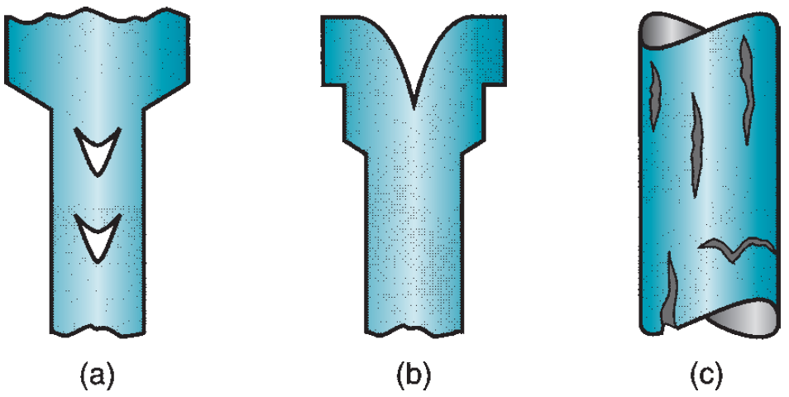
Extrusion
Defects in Extrusion
Figure 19.26 Some common defects in extrusion: (a) centerburst, (b) piping, and (c) surface cracking.

Slide 77
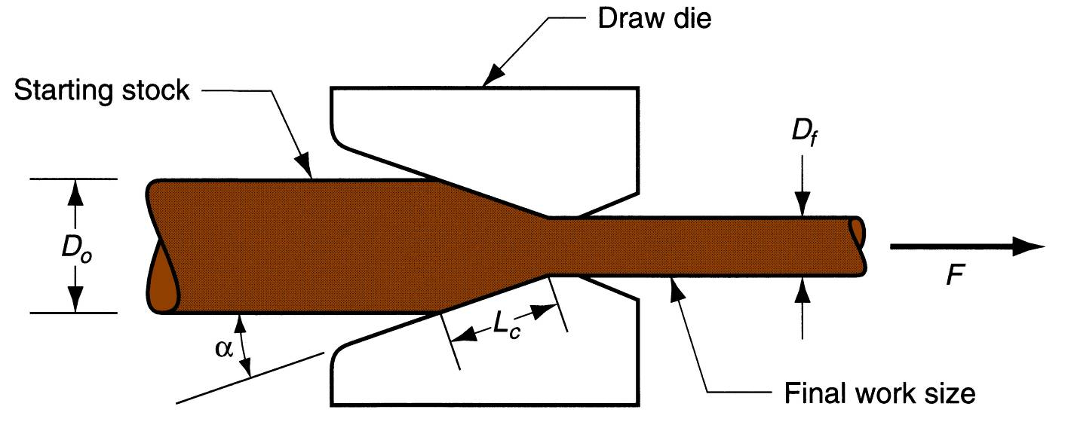
Wire and Bar Drawing
Drawing: is an operation in which the cross section of a bar, rod, or wire is reduced by pulling it through a die opening.
The difference between drawing and extrusion: the work is pulled through the die in drawing, whereas it is pushed through the die in extrusion.
Figure 19.27 Drawing of bar, rod, or wire.
.

Slide 78


Wire and Bar Drawing
Bar drawing: the term used for large diameter bars.
Wire drawing: applies to small diameter bars (wire sizes down to 0.03 mm are possible in wire drawing).
Two stress components are present is drawing; tensile stresses due to the pulling action and compressive stresses because the metal is squeezed down as it passes through the die opening.
Change in size of work (given by area reduction):
Draft: difference between original and final diameter:
Note: A is in (mm²) and D is in (mm).

Slide 79



Wire and Bar Drawing
Analysis of Drawing
Mechanics of Drawing: assume no friction.
True strain:
Stress:
where

Slide 80





Wire and Bar Drawing
Analysis of Drawing
Mechanics of Drawing: assuming friction, consider Figure 19.27 .
where σ_{d} = draw stress, MPa; μ = die-work coefficient of friction; α = die angle; and Φ is a factor that accounts for inhomogeneous deformation.
where D = average diameter of work during drawing, mm; and L_{c} = contact length of the work with the draw die.
and
Accordingly,
where F = drawing force, N.

Slide 81
Wire and Bar Drawing
Analysis of Drawing
Maximum Reduction per Pass: why entire reduction is not taken in one pass?
  As the reduction increases, draw stress increases.
  If the reduction is large enough, draw stress will exceed the yield strength of the exiting metal.
  When that happens, the drawn wire will simply elongate instead of new material being squeezed through the die opening.
  For wire drawing to be successful, maximum draw stress must be less than the yield strength of the exiting metal.

Slide 82




Wire and Bar Drawing
Analysis of Drawing
Maximum Reduction per Pass: assuming perfectly plastic material; then (n = 0 hence Y_{f} = Y), and no friction:
This means that ln (A_{o}/A_{f}) = ln (1/(1 – r)) = 1. Hence, A_{o}/A_{f} = 1/(1 - r) must equal the natural logarithm base e. that is, the maximum possible strain is 1.0:
The maximum possible area ratio is:
The maximum possible reduction is:

Slide 83
Wire and Bar Drawing
Drawing Practice
Drawing is usually performed as a cold working operation.
Most frequently used to produce round cross sections, but other shapes are also drawn.
Drawn products include:
  Electrical wire and cable; wire stock for fences, coat hangers, and shopping carts.
  Rod stock to produce nails, screws, rivets, springs, and other hardware items.
  Bar drawing is used to produce metal bars for machining, forging, and other processes.

Slide 84
Wire and Bar Drawing
Drawing Practice
Advantages include:
  Close dimensional control.
  Good surface finish.
  Improved mechanical properties such as strength and hardness.
  Adaptability to mass production.

Slide 85

Wire and Bar Drawing
Drawing Practice
Drawing Equipment: (Bar Drawing)
  Draw bench: consists of an entry table, die stand, carriage, and exit rack.
  The carriage is used to pull the stock through the draw die.
  Powered by hydraulic cylinders or motor-driven chains.
Figure 19.28 Hydraulically operated draw bench for drawing metal bars.

Slide 86
Wire and Bar Drawing
Drawing Practice
Drawing Equipment: (Wire Drawing)
  Done on continuous drawing machines that consist of multiple draw dies, separated by accumulating drums between the dies.
  Each drum, called a capstan, is motor driven to provide the proper pull force to draw the wire stock through the upstream die.
  It also maintains a modest tension on the wire as it proceeds to the next draw die in the series.
  Each die provides a certain amount of reduction in the wire, so that the desired total reduction is achieved by the series.

Slide 87

Wire and Bar Drawing
Drawing Practice
Drawing Equipment: (Wire Drawing)
Figure 19.29 Continuous drawing of wire.

Slide 88
Wire and Bar Drawing
Drawing Practice
Drawing Dies are made of tool steel, cemented carbides or diamond and they consist of 4 regions:
(1) Entry Region: usually a bell-shaped mouth that does not contact the work. Its purpose is to funnel the lubricant into the die and prevent scoring of work and die surfaces.
(2) The Approach Region: is where the drawing process occurs. It is cone-shaped with an angle (half-angle) normally ranging from about 6 to 20º.
(3) The Bearing Surface (Land): determines the size of the final drawn stock.
(4) The Back Relief: is the exit zone. It is provided with a back relief angle (half-angle) of about 30º.

Slide 89

Wire and Bar Drawing
Drawing Practice
Drawing Dies:
Figure 19.30 Draw die for drawing of round rod or wire.

Slide 90
Wire and Bar Drawing
Drawing Practice
Preparation of work: involves three steps: (1) annealing, (2) cleaning, and (3) pointing.
(1) Annealing: done to increase the ductility of the stock.
(2) Cleaning: required to prevent damage of the work surface and draw die.
(3) Pointing: involves the reduction in diameter of the starting end of the stock so that it can be inserted through the draw die to start the process. This is usually accomplished by swaging, rolling, or turning.

